Slide 1
Chapter 11: Positive Reinforcement

Slide 2
Definition
Stimulus presented
Contingent on a response
Which increases the future probability of the response
The future increase in the response is a critical feature in defining reinforcement

Slide 3
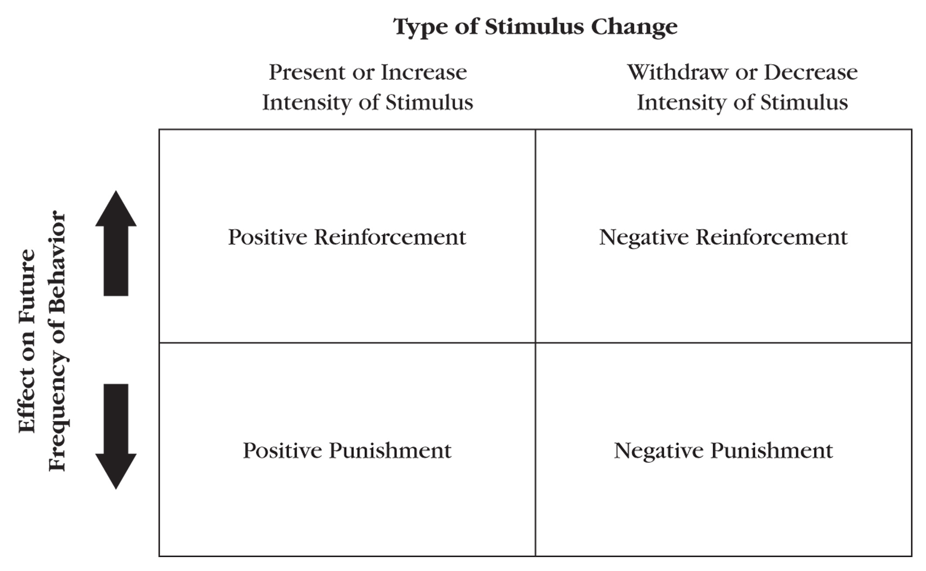
Type of Stimulus Change

Slide 4
Circular Reasoning
Faulty logic in which the name used describe the effect is also mistaken for the cause of the phenomenon
Example: Johnny has trouble learning to read (effect). Therefore, he has a learning disability (phenomenon). How do I know he has a learning disability? Because he can’t read (effect now translated into cause)
Notes:
Reinforcement is not a circular concept

Slide 5
The Role of Antecedent Stimuli
Caveat #1: Reinforcement does not increase behavior under all conditions
The temporal relation important!
Antecedent variables
Responses
Consequences
These antecedent variables become discriminitive stimuli (S^{D}s)
Thus, the response is more likely to occur in the future in the presence of these stimuli

Slide 6
The Discriminated Operant
AKA “The Three-term Contingency”
S^{D}
Tap on faucet marked with blue dot or letter “C”
Response
Turn tap with blue dot or “C”
S^{R+}
Cold water presented
Turning tap marked with blue dot or “C” occurs more often in the future
This term is referred to as “the reinforcer”

Slide 7
The Role of Antecedent Stimuli
Caveat #2: Reinforcement depends on motivation
The S^{D} will only signal the response if the individual is motivated to engage in the response
Motivating Operations (MOs)
Alter the reinforcing effectiveness of stimuli, and thus
Alter the momentary frequency of responses reinforced by those stimuli

Slide 8
Motivating Operations
Establishing Operations (EO)
Increases the effectiveness of a stimulus as a reinforcer
Usually involves decreased access to the stimulus (deprivation)
Abolishing Operation (AO)
Decreases the effectiveness of a stimulus as a reinforcer
Usually involves having increased access to the stimulus (satiation)

Slide 9
The Four-term Contingency
The consideration of MOs are important in relation to the three-term contingency
EO
Deprived of water for a long period of time
S^{D}
Tap on faucet marked with blue dot or letter “C”
Response
Turn tap with blue dot or “C”
S^{R+}
Cold water presented
Turning tap marked with blue dot or “C” occurs more often in the future when the individual has been deprived of water for periods of time
We only expect blue tap-turning behavior when the person “wants” water (i.e., is thirsty)

Slide 10
Questions About Reinforcement
Does a person have to be aware that a response is being reinforced for it to increase?
NO! The effect is automatic.
Are certain behaviors susceptible to reinforcement and others are not?
NO! The only relevant relevant property is the temporal relation between the response and the consequence.

Slide 11
Immediacy of Reinforcement
It is critical that the consequence is delivered immediately following the target response
Problems with delays to reinforcement
Other behaviors occur during the delay
The behavior temporarily closest to the presentation of the reinforcer will be strengthened

Slide 12
Delayed Reinforcement
Does not necessarily reinforce the target behavior; rather influences it
Instructional Control/Rule Following
Rule: verbal description of a behavioral contingency
Can allow delayed consequences to influence behavior

Slide 13
“Rule-governed Behavior”
Indicators
No immediate consequence apparent
Response-consequence delay > 30 s
Large increase in frequency of the behavior occurs following one instance of reinforcement
No consequence for the behavior exists (including no automatic reinforcement), but rule does

Slide 14
Superstitious Behavior
Occurs when reinforcement “accidentally” follows a behavior that did not produce the reinforcement
Sports players who equate putting on a certain pair of socks with winning a game (leading to the “lucky socks” idea)
A teacher consoling a child who hurt himself may reinforce crying and/or hurting oneself

Slide 15
Automatic Reinforcement
Reinforcement that occurs independent of another person delivering it
The response, itself, produces the reinforcement
Examples
Wiggling your leg during a boring lecture to stimulate yourself and stay awake
Note: This does not mean the behaviors are automatic (i.e., “reflexive”); rather that the consequences are delivered automatically

Slide 16
Classifying Reinforcers

Slide 17
Reinforcers by Origin
Unconditioned Reinforcers (AKA primary or unlearned reinforcers)
Function as reinforcers due to heredity/evolution
Do not require any learning history to become reinforcers
Examples: Food, water, oxygen, warmth, sexual stimulation, human touch

Slide 18
Reinforcers by Origin
Conditioned Reinforcers (AKA secondary or learned reinforcers)
Neutral stimuli that begin to function as reinforcers as a result of being paired with other reinforcers (either conditioned or unconditioned)
Can also condition reinforcers through verbal analog conditioning
Examples: Yellow paper, stickers, tokens

Slide 19
Generalized Conditioned Reinforcers
A type of conditioned reinforcer that has been paired with many conditioned and unconditioned reinforcers
Do not depend on a specific EO to be effective
Examples: tokens, money, points

Slide 20
Reinforcers by Formal Properties
Edible reinforcers (food)
Sensory reinforcers (massage, tickles)
Tangible reinforcers (trinkets, toys)
Activity reinforcers (playing a game, recess)
Social reinforcers (physical proximity, social interaction)
Bear this in mind:
Items that function as reinforcers are idiosyncratic across people!

Slide 21
Identifying Potential Reinforcers
It is important to identify reinforcers empirically
Staff, parents, teachers, and even children themselves who report what they believe to be reinforcers are often wrong
Two strategies to use in tandem
Stimulus Preference Assessments
Reinforcer Assessments

Slide 22
Caveats Regarding Preference/Reinforcer Assessments
Preference changes over time
Evaluate frequently
Preference assessments do not identify the reinforcing effects of stimuli
Just because people prefer paper towels to hot-air hand dryers in public restrooms doesn’t mean they’ll work to earn paper towels!

Slide 23
Stimulus Preference Assessments
Identify
Stimuli a person prefers
Relevant preference values
Conditions under which these preferences hold true

Slide 24
Stimulus Preference Assessments
Three Categories
Asking about stimulus preferences
Observing the target person under free-operant conditions
Presenting various stimuli in a series of trial-based observation

Slide 25
Asking About Stimulus Preferences
Ask the Target Person
Open-ended questions (“What would you like to work for?”)
Asking about specific items (“How would you like to work for stickers?”)
Choice format (“Would you rather work for things to eat or things to do?”)
Rank order format

Slide 26
Asking About Stimulus Preferences
Offering Pre-task Choices
When you are finished working, you can play with Battleship, checkers, or the computer
Premack Principle
Asking Significant Others
Ask caregivers to identify preferred stimuli

Slide 27
Asking About Stimulus Preferences
A relatively uncomplicated procedure
Problems
Verbal reports may not correspond to actual behavior
High number of false positives and low number of false negatives

Slide 28
Free-Operant Observation
Observing and recording what activities the target person engages in when he/she has unrestricted choice of activities
No response requirements
All stimuli available within sight and reach
Items are never removed
Can be contrived or naturalistic

Slide 29
Contrived Free-Operant Observation
Just prior to observation, provide learner with noncontingent exposure to each item (for sampling purposes)
Place all items in view and within reach
Observe for a set period of time and record the duration of time target person engages with each stimulus item

Slide 30
Naturalistic Free-Operant Observation
Conducted in everyday environments as unobtrusively as possible (e.g., during recess)
Observe for a set period of time and record the duration of time target person engages with each stimulus item/activity

Slide 31
Advantages of Free-Operant Assessments
Less time consuming than some trial-based methods of preference assessment
Less likely to produce problem behavior because preferred stimuli are never removed

Slide 32
Trial-Based Methods
General Procedure
Present selected stimuli to children in a series of trials
Measure approach (e.g., eye gaze, hand reach), contact (e.g., touch/hold), and/or engagement (e.g., interacting with stimulus)
Can categorize as high, medium, and low preference
Many variations for procedure

Slide 33
Trial-based Method 1: Single Stimulus Presentation
Present stimuli, one at a time, in random order and record target person’s reaction to it
Well suited for individuals who have difficulty selecting among two or more stimuli

Slide 34
Trial-based Method 2: Paired Stimuli Presentation
Sometimes called “forced-choice” method
Present two stimuli simultaneously and ask the target person to choose one
Each stimulus is matched to every other stimulus in the set
Rank order from high, medium, and low preference

Slide 35
Trial-based Method 3: Multiple Stimulus Presentation
Extension of the paired-stimuli presentation
Present an array of 3 or more stimuli together
Two major variations:
With replacement
Stimulus selected remains in array in subsequent trials
Without replacement
Selected stimulus is removed from array in subsequent trials (takes about half the time to complete the procedure, and it is still fairly accurate)

Slide 36
Trial-based Method 3: Multiple Stimulus Presentation
Begin trial with: Which one do you want the most?
Repeat several times

Slide 37
Guidelines for Selecting and Using Stimulus Preference Assessments
Monitor target person’s activities prior to assessment to be aware of EOs that may affect results
Balance cost-benefits of procedures (time to do vs. level of confidence)
Balance rankings vs. no rankings with shifts of preference
When time is limited, use fewer stimuli in array
When possible, combine data from multiple assessment procedures

Slide 38
Reinforcer Assessment
A direct, data-based method in which
One or more stimuli are presented
Contingent on a target response, and
Observing whether an increase in responding occurs
Allows you to verify/confirm whether a stimulus functions as a reinforcer

Slide 39
Concurrent Schedule Reinforcer Assessment
Pit two stimuli against each other and observe which produces the larger increase in responding
Allows you to determine differences between relative and absolute reinforcement effects
Notes:
How to reaction to math work sheet
Relative: going to increase 5 10 trials
Absolute: 10 trials no matter how many trials

Slide 40
Multiple Schedule Reinforcer Assessment
Two or more component schedules of reinforcement for a single response with only one component schedule in effect at a given time
An S^{D} signals the presence of each component schedule and is present while that component is in effect

Slide 41
Progressive-Ratio Schedule Reinforcer Assessment
Preferences may change when response requirements increase
Progressive-ratio schedules provide a framework for assessing relative effectiveness of a stimulus as reinforcement as response requirements increase
Response requirements are systematically increased over time until responding declines

Slide 42
Control Procedures for Positive Reinforcement
DRO may be another appropriate control procedure
May produce a reversal more quickly than the NCR schedule
DRA could be used as a control procedure to reinforce another alternative response
Notes:
DRO stop bleeding:
DRA incompetible behavior, alternative behavior

Slide 43
Control Procedures for Positive Reinforcement
Limitations of DRO/DRA as controls
Introduce new contingencies that were not present in original experimental arrangement
Reversals may be due to
Termination of a contingency between target response and reinforcer
Introduction of reinforcement for absence of the target response or for the occurrence of a competing response

Slide 44
12 Guidelines for Using Reinforcement Effectively
Choose reinforcers relevant to current or creatable establishing operations
Maintain establishing operations
Use high-quality reinforcers of sufficient magnitude
Set an easily achieved initial criterion for reinforcement -criterion should be less than or equal to best performance during baseline

Slide 45
12 Guidelines for Using Reinforcement Effectively
Explain the contingency and provide prompts to respond
Deliver the reinforcer immediately following behavior
Reinforce each occurrence of the behavior initially
Use direct rather than indirect reinforcement contingencies

Slide 46
12 Guidelines for Using Reinforcement Effectively
Gradually increase response-to-reinforcement delay
Use varied reinforcers
Use contingent praise and attention
Shift from contrived to naturally occurring reinforcers

